Slide 1

Herefordshire Local Plan
Members’ Seminar
9 October 2015
Notes:
Welcome to your new corporate Powerpoint template.
The margins are pre-set to align with the corporate composition zones - never move the guides.
Cover picture size is 254x98.04 (100px/in)

Slide 2


Key Sections
Why do we need a Plan?
What stages have we been through?
What was included in the submission plan?
The outcome of the examination
The significance of the outcomes
The next steps
Notes:
Go to insert > duplicate slide to add more slides

Slide 3
Why do we need a plan?
Notes:
Go to insert > duplicate slide to add more slides

Slide 4
Why do we need a Plan?
Plan-led system since 1990
UDP adopted 2007
Lifespan to 2011
Now saved
NPPF reinforces importance of up-to-date local plan
Promotion of sustainable development
To deliver co-ordinated growth
Notes:
Go to insert > duplicate slide to add more slides

Slide 5
What stages have we been through?
Notes:
Go to insert > duplicate slide to add more slides

Slide 6

Notes:
Welcome to your new corporate Powerpoint template.
The margins are pre-set to align with the corporate composition zones - never move the guides.
Cover picture size is 254x98.04 (100px/in)

Slide 7
The Details (1)
Issues Paper September 2007
Developing Options June 2008
Place Shaping January 2010
Draft Options July 2010
Draft Plan September 2011
Shaping Our Place March 2013
Notes:
Go to insert > duplicate slide to add more slides

Slide 8
The Details (2)
Submission September 2014
Hearing February 2015
Main Modifications April 2015
Modifications – National Policy May 2015
Inspector’s Report September 2015
Cabinet/Council October 2015
Notes:
Go to insert > duplicate slide to add more slides

Slide 9
What was included in the submission plan?
Notes:
Go to insert > duplicate slide to add more slides

Slide 10
Contents of Submission Plan
Balanced package of growth and environmental issues
A strategy for sustainable growth up to 2031
Delivering infrastructure with overall growth
Investment in the market towns
Balanced and proposed rural growth
Notes:
Go to insert > duplicate slide to add more slides

Slide 11
Summary of main proposals
County-wide - Housing
16,500 new dwellings over the plan period will meet objectively assessed need and enable economic growth.
Based on past County-wide rates of development this is a realistic level of growth over a 20 year period.
Notes:
Go to insert > duplicate slide to add more slides

Slide 12
Strategy – Housing distribution
The Plan Period will cover 2011 to 2031
Overall housing totals
County Target 16,500
Hereford Target 6,500
Market Towns Target 4,700
Rural Areas Target 5,300
Notes:
Go to insert > duplicate slide to add more slides

Slide 13
Strategy - Hereford
Hereford remains principal focus for development – 6,500 dwellings
Employment proposals focussed at Rotherwas Enterprise Zone (outside of Local Plan process) and new employment land as part of Urban Extensions
Package of transport measures for Hereford to include sustainable measures and Hereford relief road
Notes:
Go to insert > duplicate slide to add more slides

Slide 14
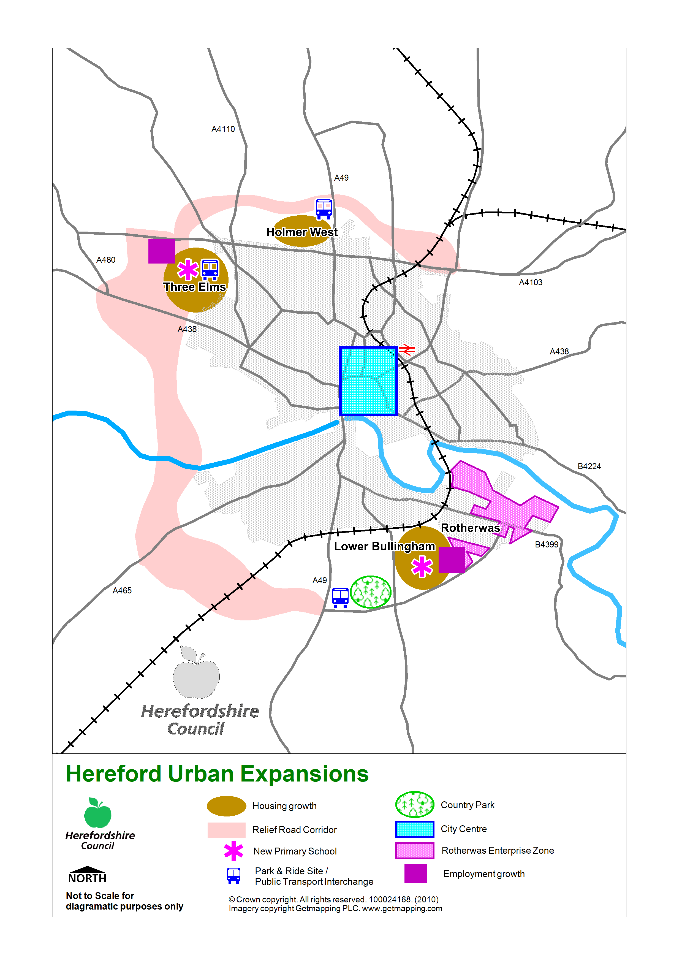
Hereford Proposals
Holmer West: 500 new homes
Three Elms: 1000 new homes, employment growth
Lower Bullingham: 1000 new homes, expansion of Rotherwas
City Centre: 800 dwellings (urban village)
Notes:
Go to insert > duplicate slide to add more slides

Slide 15
Strategy – Market Towns
Leominster 2,300 houses Urban extension and 10ha employment, southern link road as part of urban extension
Ross-on-Wye 900 houses Hildersley, strategic housing site, employment land provision at Model Farm
Ledbury 800 houses Viaduct strategic housing site, new employment land off Much Marcle Road
Bromyard 500 houses Hardwick Bank strategic housing site.
Kington 200 houses no strategic sites
Notes:
Go to insert > duplicate slide to add more slides

Slide 16
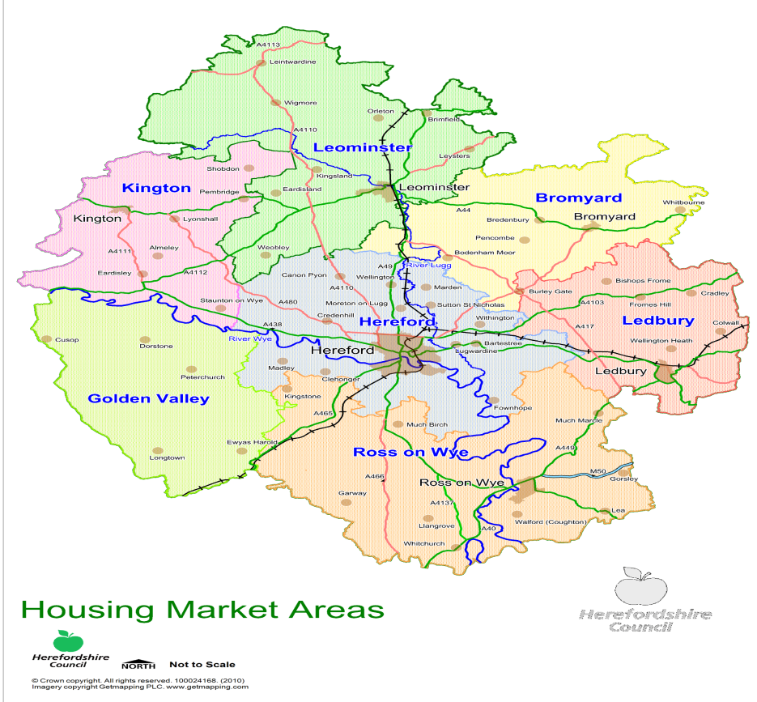
Strategy – Rural areas
5,300 new houses across all rural areas
Potential for more than 200 rural settlements to grow
Employment proposals encouraged where they would diversify the economy
Important role of Neighbourhood Development Plans in delivering the Core Strategy in rural areas
Notes:
Go to insert > duplicate slide to add more slides

Slide 17
General policies
The Plan also contains a range of other topic specific policies such as those dealing with
Water quality & Sustainable water management
Local Distinctiveness
Affordable Housing
Renewable energy
Notes:
Go to insert > duplicate slide to add more slides

Slide 18
The outcome of the examination
Notes:
Go to insert > duplicate slide to add more slides

Slide 19
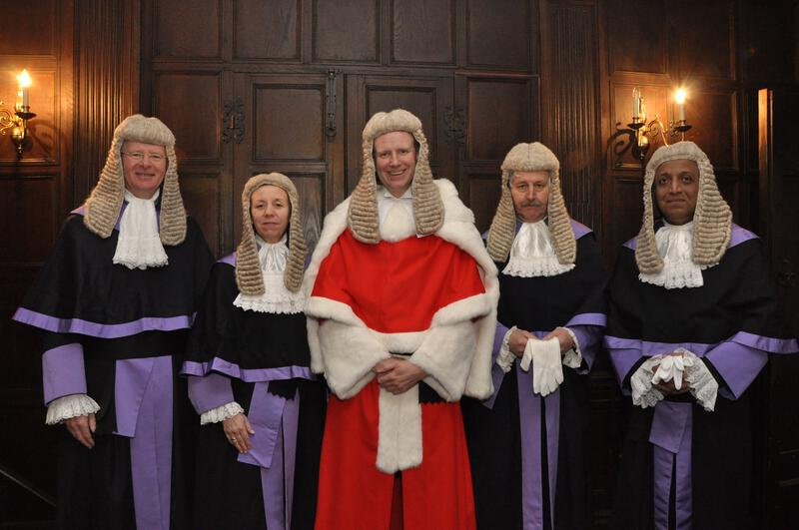
The Inspector’s report
Received on 29 September 2015
Sets out key findings on soundness
Identifies modifications necessary to achieve soundness
A summary of the debates on matters and topics
Identifies Plan as a positive basis for the future planning of the county
Notes:
Go to insert > duplicate slide to add more slides

Slide 20


Notes:
Go to insert > duplicate slide to add more slides

Slide 21
The modifications
Main modifications
Those necessary to achieve soundness
Main modifications
Some significant/some less significant (wording etc.)
Minor modifications
For the Council’s discretion
The modifications will be incorporated into the Plan on adoption
Notes:
Go to insert > duplicate slide to add more slides

Slide 22
What has not changed?
Inspector’s Report no changes recommended to the spatial strategy in respect of
  Overall scale and distribution of housing/employment
  Proposals for major infrastructure
Notes:
Go to insert > duplicate slide to add more slides

Slide 23
The significance of the outcomes
Notes:
Go to insert > duplicate slide to add more slides

Slide 24
The significant main modifications - MM07
Growth and infrastructure
Importance of annual monitoring process
Housing trajectory in Appendix 4
If delivery is below the cumulative target figure appropriate review mechanisms kick in
Appendix 5 – links between delivery and housing and infrastructure
Links back to appropriate mechanisms
Notes:
Go to insert > duplicate slide to add more slides

Slide 25

Notes:
Go to insert > duplicate slide to add more slides

Slide 26
Notes:
Go to insert > duplicate slide to add more slides

Slide 27
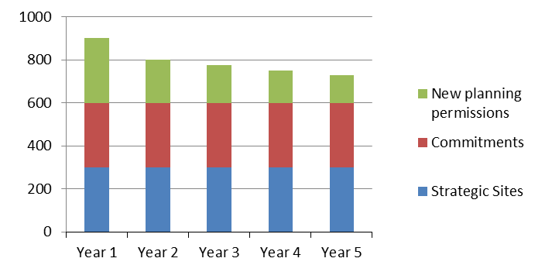
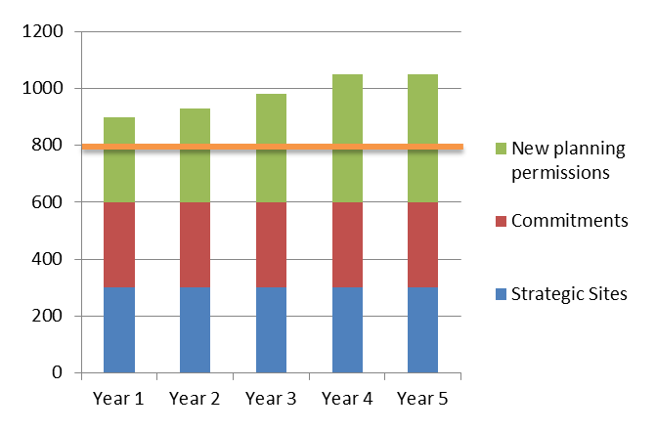
At any point over the lifetime of the Core Strategy….
Decreasing 5 year supply
Robust 5 year supply
Notes:
Go to insert > duplicate slide to add more slides

Slide 28

Notes:
Go to insert > duplicate slide to add more slides

Slide 29
The significant main modifications – MM01
Minerals and Waste
Delete policies M1-M6/W1-W5
Delete all associated text
Replace with revised text setting out new architecture of Plan
Future preparation of a Minerals and Waste Local Plan
Captured in Local Development Scheme
Due to be adopted Autumn 2016
Notes:
Go to insert > duplicate slide to add more slides

Slide 30
The significant main modifications – MM036/37
Rural growth and the role of neighbourhood plans
5,300 dwellings is robust and there is the necessary capacity to deliver (but to be minimum)
Proportionate growth in each HMA to be indicative
Neighbourhood plans to identify the most suitable housing sites
Local evidence and environmental factors would inform scale of development
MM037 sets out a number of criteria to ensure local responsiveness
Notes:
Go to insert > duplicate slide to add more slides

Slide 31
The next steps
Notes:
Go to insert > duplicate slide to add more slides

Slide 32
The next steps
Cabinet 15 October
Council 16 October
Decision on adoption
Options – adopt/not adopt
Main modifications – the package to make the Plan sound
Minor modifications – for clarification
Notes:
Go to insert > duplicate slide to add more slides

Slide 33

What happens if the Plan is adopted?
A fully up-to-date strategic plan
A locally produced plan in conformity to NPPF
A five year housing land supply
‘An appropriate basis for the planning of the county’
Basis to proceed to final stages of CIL
Neighbourhood plans roll out and provision of 25% of CIL funding for local infrastructure
Notes:
Go to insert > duplicate slide to add more slides

Slide 34
Notes:
Go to insert > duplicate slide to add more slides

Slide 35
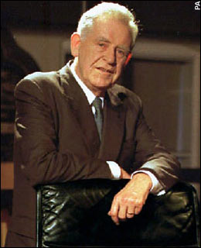
What we have started and need to finish
*Minerals and Waste Local Plan
*Hereford Area Plan
*Travellers’ Development Plan Document
*Rural Site Allocation Development Plan Document
Community Infrastructure Levy
*These are identified in the Inspector’s report
Notes:
Go to insert > duplicate slide to add more slides

Slide 36
What happens if the Plan is not adopted?
Still need a plan
Immediate need to prepare a revised submission draft
Submit for new examination
No five year housing land supply
Default position to NPPF
Risk of sporadic development
No mechanism in place to fund infrastructure
Notes:
Go to insert > duplicate slide to add more slides

